Slide 1

Theoretical Modeling SIO 134
Alaina Smith
ans132@ucsd.edu
Notes:
My goals for this lesson is that students understand the key concepts of modeling, successfully reproduce a simple model example, understand how the model parameters affect the model, and begin conceptualizing a model for a system they are interested in. Learning how to code and write models is definitely a hands on task. Since we can’t be together in person, and I am recording this I am going to run through it and

Slide 2
What is theoretical modeling?
“Models are to theoretical problems as experiments are to empirical problems.” – Caswell, H. (1988). Ecological Modelling. 43: 33-44.
Theory
Math
Hypothesis testing
Repeat

Slide 3
What can it be used for?
Literally anything your heart desires. Most everything can be boiled down to some basic mathematic relationships. We don’t always know the real-world constraints and dynamics but models can be used to test different hypotheses and compared to the real world, or predict forward, etc.

Slide 4
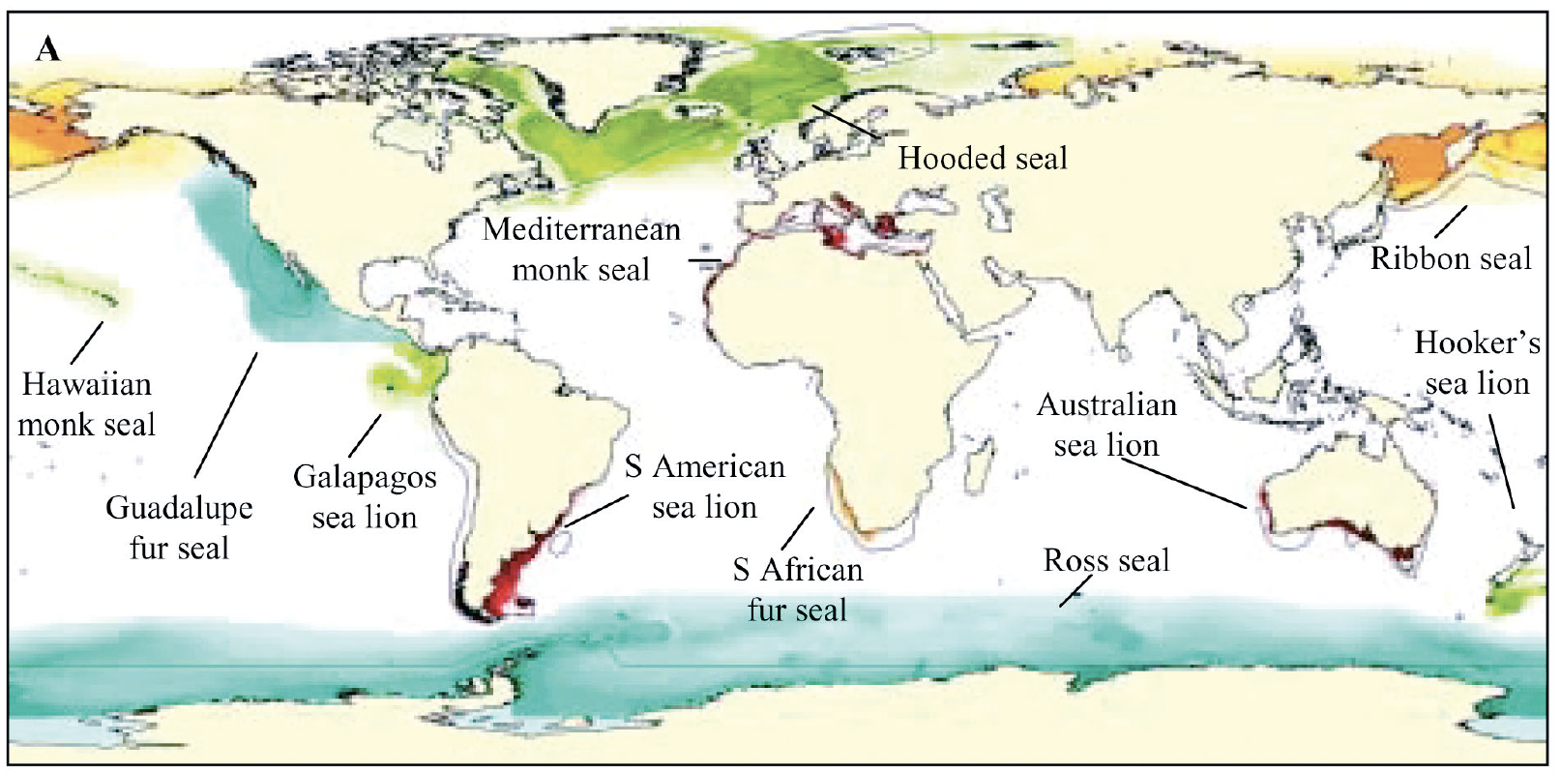
Example: Megafauna Species Distribution
Figure 1. Relative environmental suitability (RES) predictions (ranging from less suitable [light] to very suitable [dark]) based on habitat
usage information for 11 pinniped species.
Kaschner et al. (2006). Mar. Ecol. Prog. Ser.

Slide 5
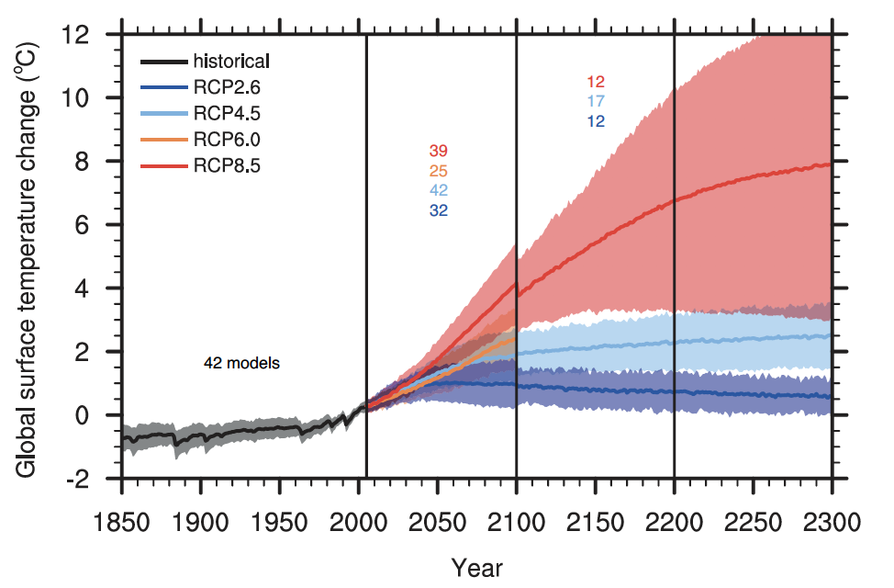
Example: Temperature increase under different climate scenarios (IPCC AR5)
Figure 2. Time series of global annual mean surface air temperature anomalies (relative to 1986–2005) from CMIP5 concentration-driven experiments. Projections are shown for each RCP for the multi-model mean (solid lines) and the 5 to 95% range (±1.64 standard deviation) across the distribution of individual models (shading). Only one ensemble member is used from each model and numbers in the figure indicate the number of different models contributing to the different time periods.
Collins et al. (2013). Chapter 13: IPPC Report AR5

Slide 6
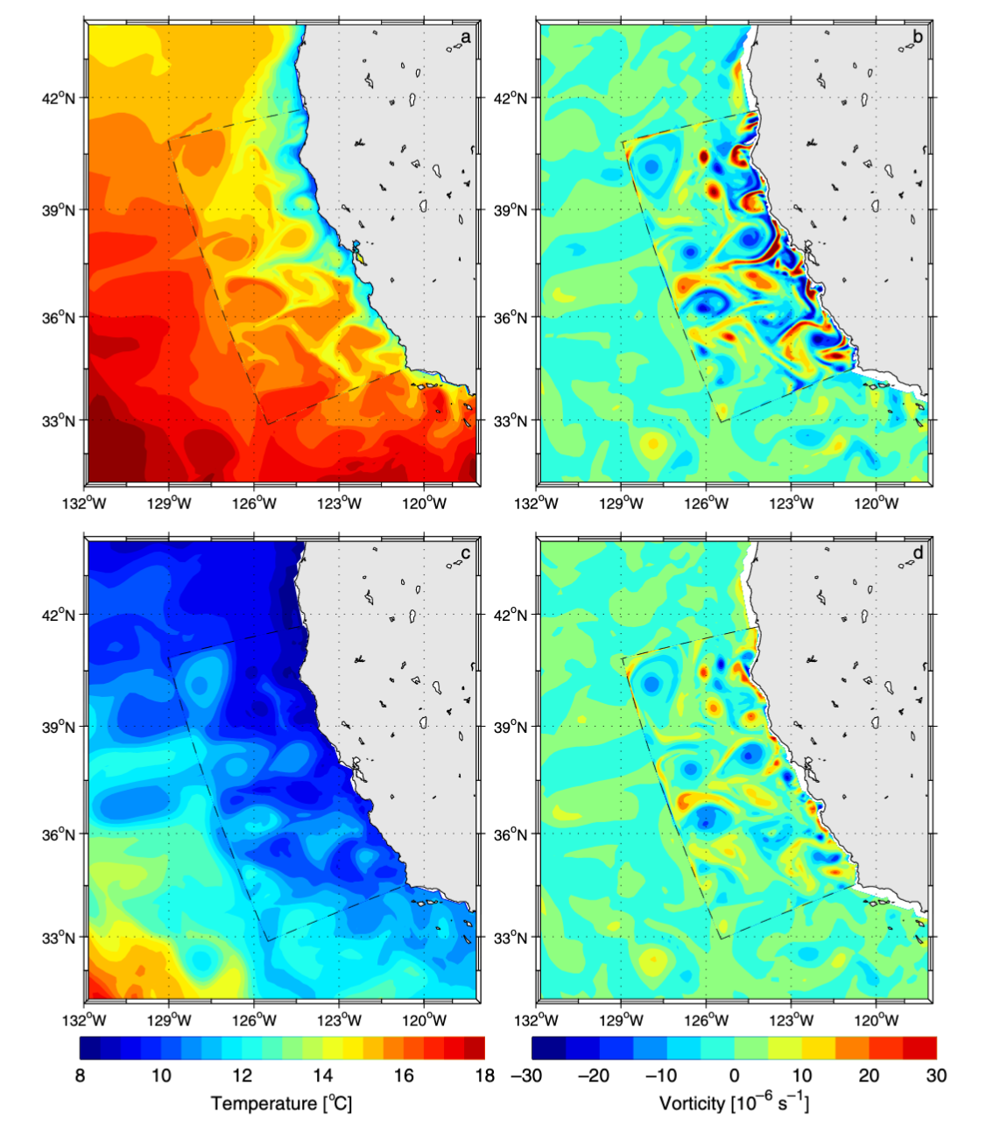
Example: CCE Temperature and Current/Eddy Dynamics
a.
b.
c.
d.
Figure 3. Model solutions for 8 July of model year 5. (a) Sea-surface temperature (°C), (b) surface vorticity (s⁻¹), (c) temperature (°C) at 100 m depth, and (d) vorticity (s⁻¹) at 100 m depth
Penven et al. (2006). Ocean Modelling.

Slide 7
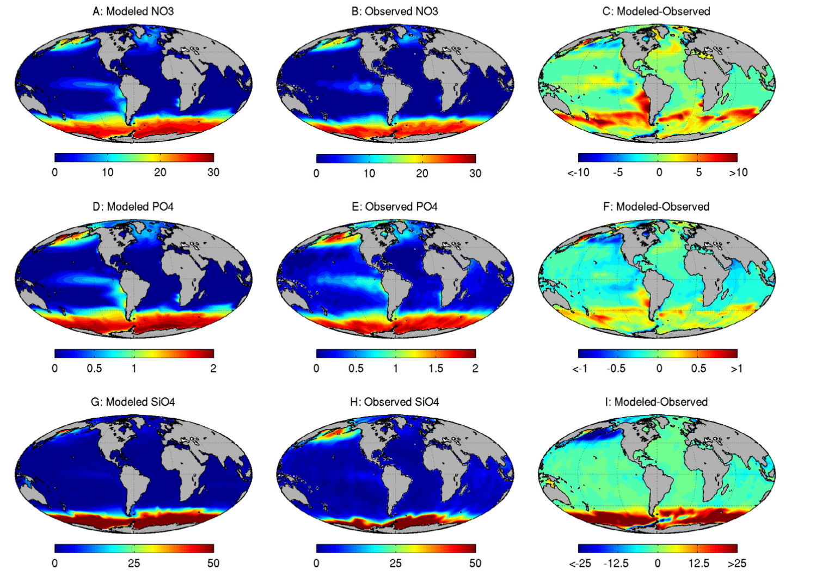
Example: Global ocean biogeochemical cycling
Figure 4. Surface macronutrient concentrations. Top panels (A–C): annual observed (World Ocean Atlas) and modeled surface nitrate concentration (mmol NO3m³), and model – observed. Middle Panels (D–F): annual mean observed (World Ocean Atlas) and modeled surface phosphate concentration (mmol PO4m³), and model – observed. Lower panels (G–I): annual mean observed (World Ocean Atlas) and modeled surface silicate concentration (mmol SiO4m³), and model – observed.
Stock et al. (2014). Prog. Oceano.

Slide 8
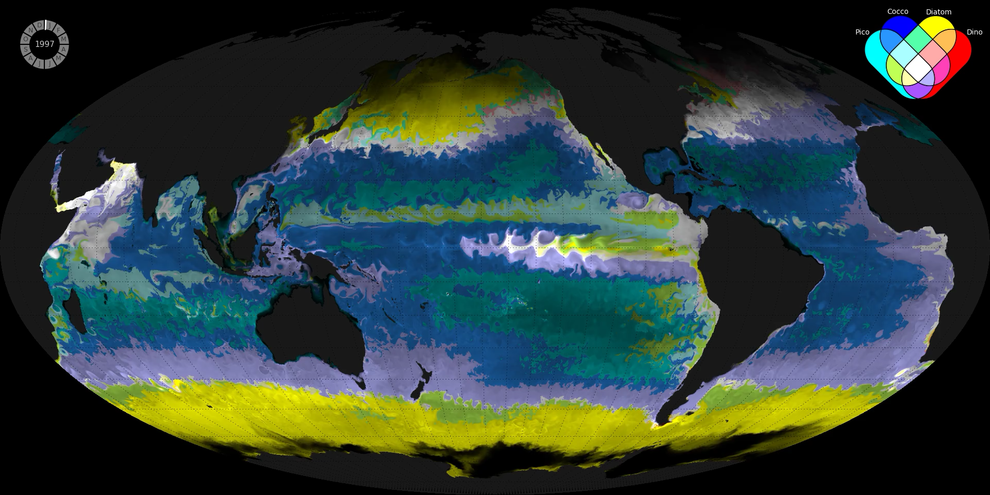
Example: Darwin Model - Phytoplankton Group Distributions
Figure 5. Ecological Provinces from a computer simulation of the marine global ecosystems. Each color represents a different distinct combination of the most dominant phytoplankton function types (as shown in the Venn diagram top right). The opacity indicates the total concentration of phytoplankton biomass: the darker the color, the less phytoplankton. – Video Credit: Oliver Jahn, MIT
Follows et al. (2007). Science

Slide 9
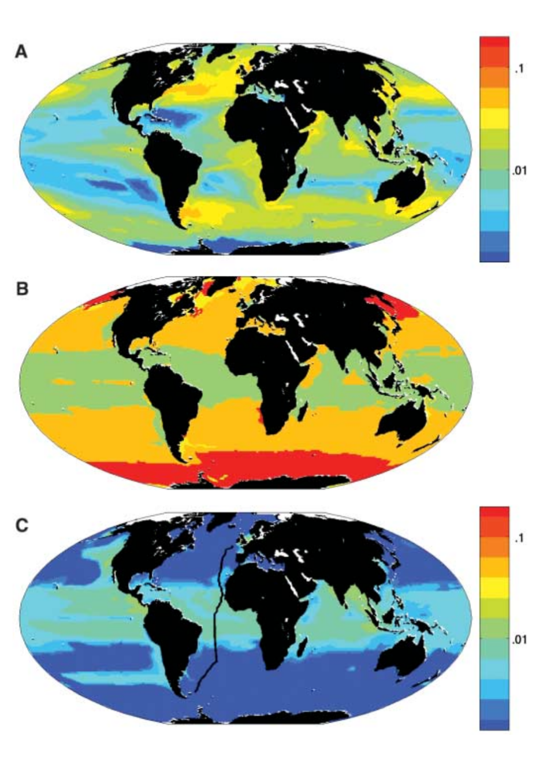
Use models to answer specific questions about community dynamics
Figure 6. Annual mean biomass and biogeography from single integration.
Total phytoplankton biomass (μM P, 0 to 50 m average).
Emergent biogeography: Modeled photo-autotrophs were categorized into four functional groups; color coding is according to group locally dominating annual mean biomass. Green, analogs of Prochlorococcus; orange, other small photo-autotrophs; red, diatoms; and yellow, other large phytoplankton.
Total biomass of Prochlorococcus analogs (μM P, 0 to 50 m average).
Follows et al. (2007). Science.
Question: How does phytoplankton biomass change with latitude?
Question: Does the dominance of different phytoplankton size classes change with latitude?
Question: Where are the highest abundances of Prochlorococcus across the globe?
Notes:
Fig. 1 A: Biomass, B. Dominance of different size classes, C. only Prochlorococcus Fig. 1. A : Historic distributions of three species of phytoplankton, B: Predicted future distributions and then C: changes in the model.

Slide 10
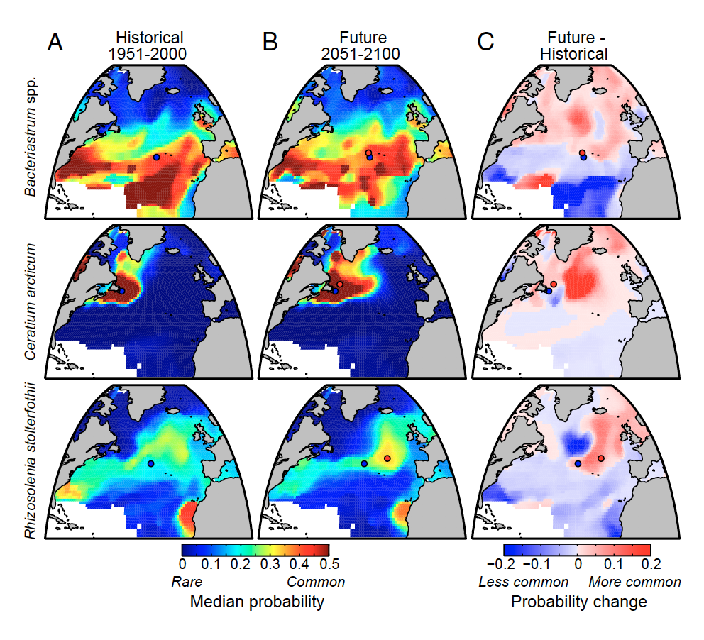
Use models to answer specific questions about community dynamics
Question: How will phytoplankton species distribution be affected by changing sea surfaces temperatures as a result of global climate change?
Figure 7. Estimated biogeographies for Bacteriastrum
spp. (diatom), Ceratium arcticum (syn. Neoceratium
arcticum; dinoflagellate), and Rhizosolenia stolterfothii
(syn. Guinardia striata; diatom) in 1951–2000 (A)
and 2051–2100 (B) and the change in probability of
occurrence (2051–2100 − 1951–2000) (C). Map colors
in A and B indicate annual median probability of occurrence,
and colors in C indicate difference in annual
median probability of occurrence; white areas are
outside range of environmental training data.
Barton et al. (2016). PNAS.
Notes:
Fig. 1 A: Biomass, B. Dominance of different size classes, C. only Prochlorococcus Fig. 1. A : Historic distributions of three species of phytoplankton, B: Predicted future distributions and then C: changes in the model.

Slide 11
What kinds of things do I use it for?
BROADLY
Why are there so many phytoplankton species co-existing in such a smaller area when they compete for the same resources?
What are the underlying mechanisms that result in the typical biogeographical patterns we can observe in the field?
Understanding current dynamics to better predict future dynamics.

Slide 12
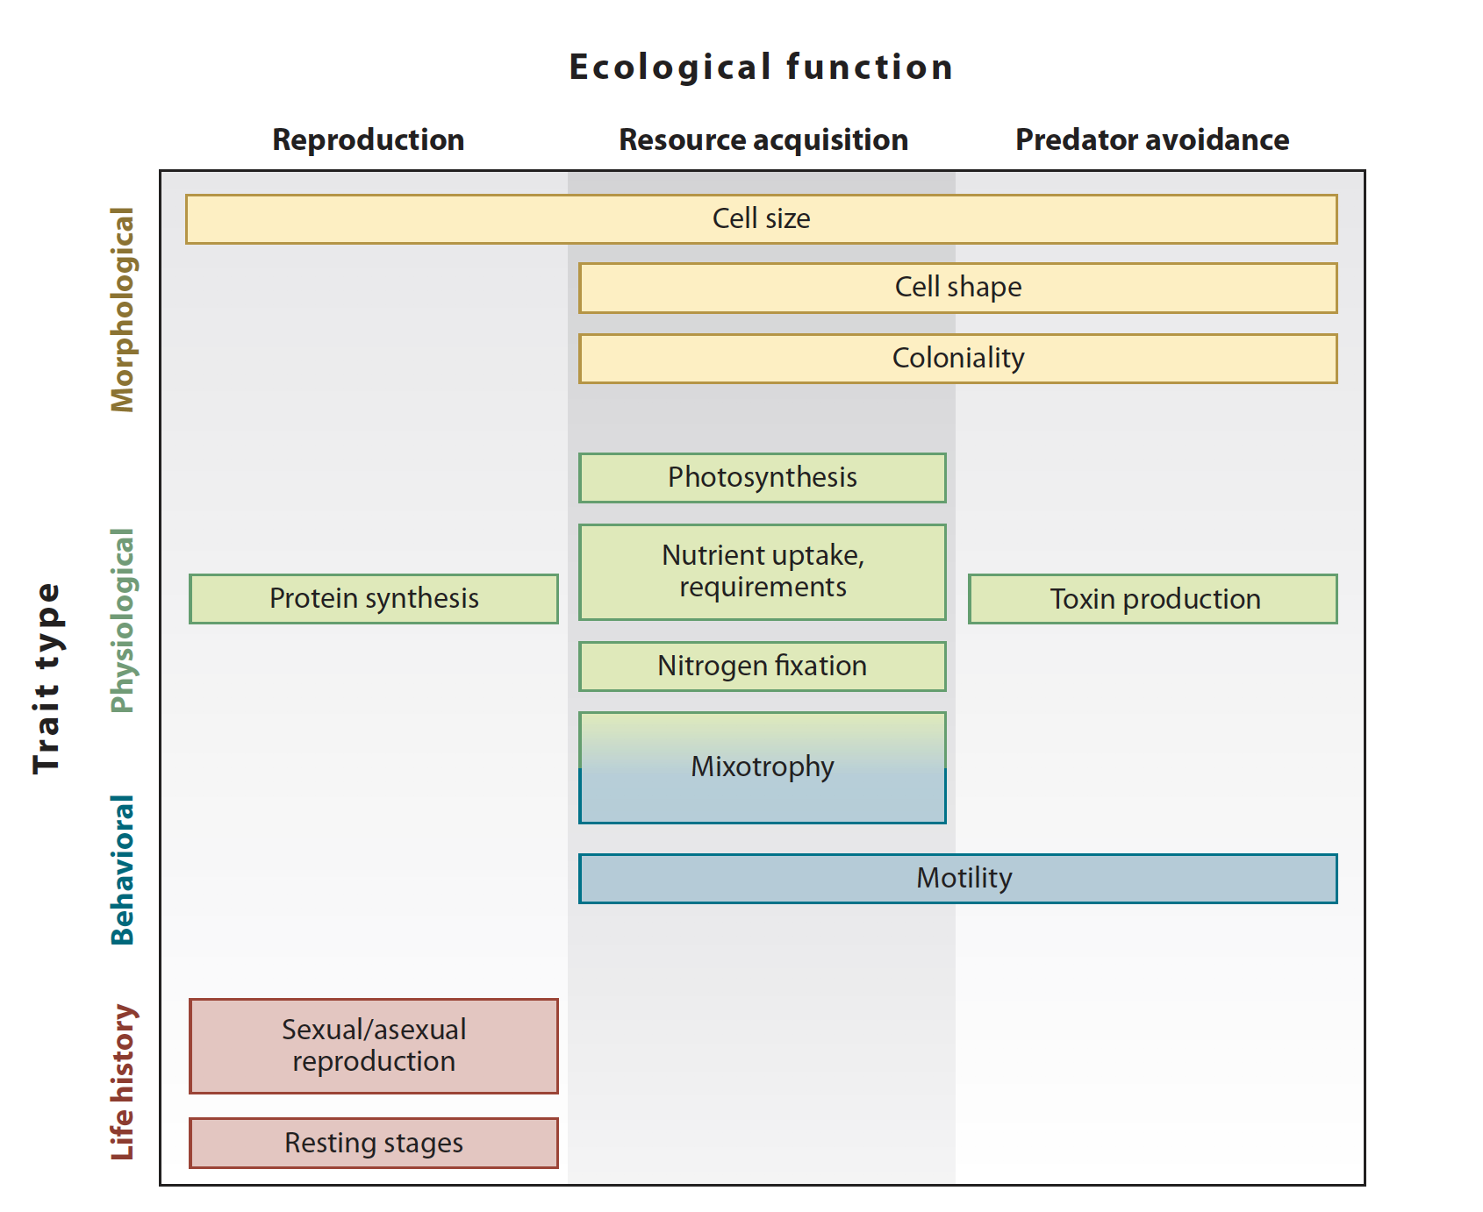
QUICK INTRO/ REFRESHER TO PLANKTON COMPETITION THEORY
Litchman and Klausmeir. (2008). ARES.

Slide 13
QUICK INTRO/ REFRESHER TO PLANKTON COMPETITION THEORY
Litchman and Klausmeir. (2008). ARES.

Slide 14
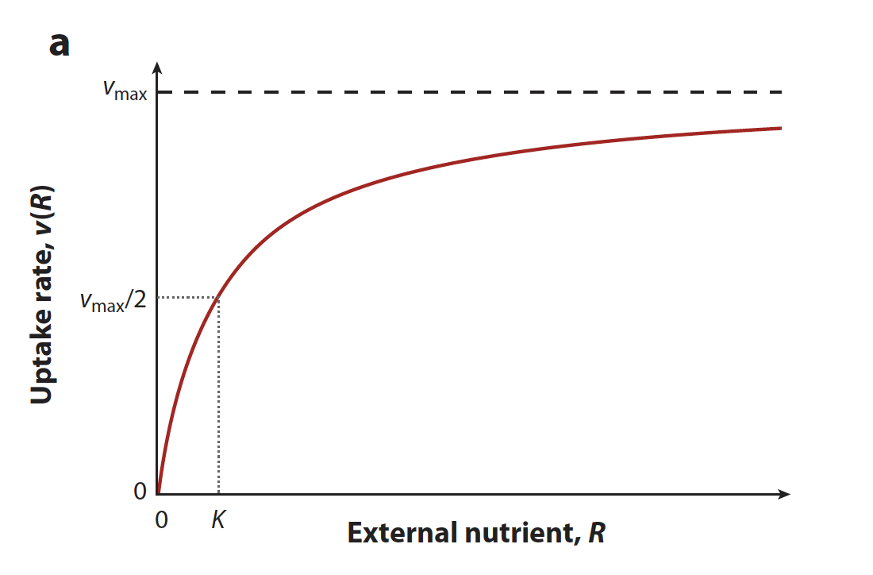
QUICK INTRO/ REFRESHER TO PLANKTON COMPETITION THEORY
Michaelis-Menten Uptake Kinetics
Litchman and Klausmeir. (2008). ARES.

Slide 15
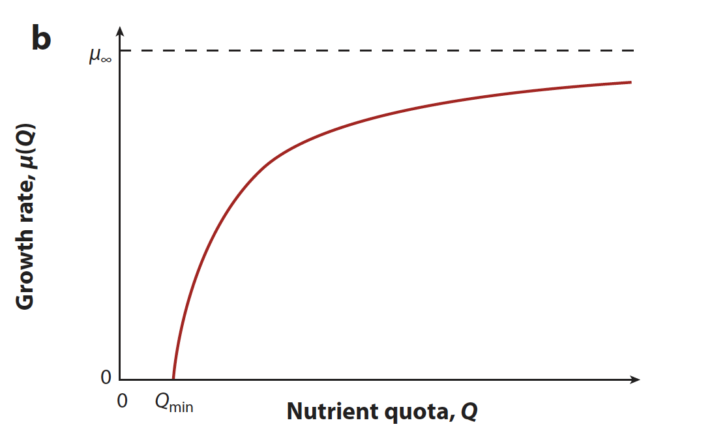
QUICK INTRO/ REFRESHER TO PLANKTON COMPETITION THEORY
Michaelis-Menten Uptake Kinetics
Droop growth function
Litchman and Klausmeir. (2008). ARES.

Slide 16
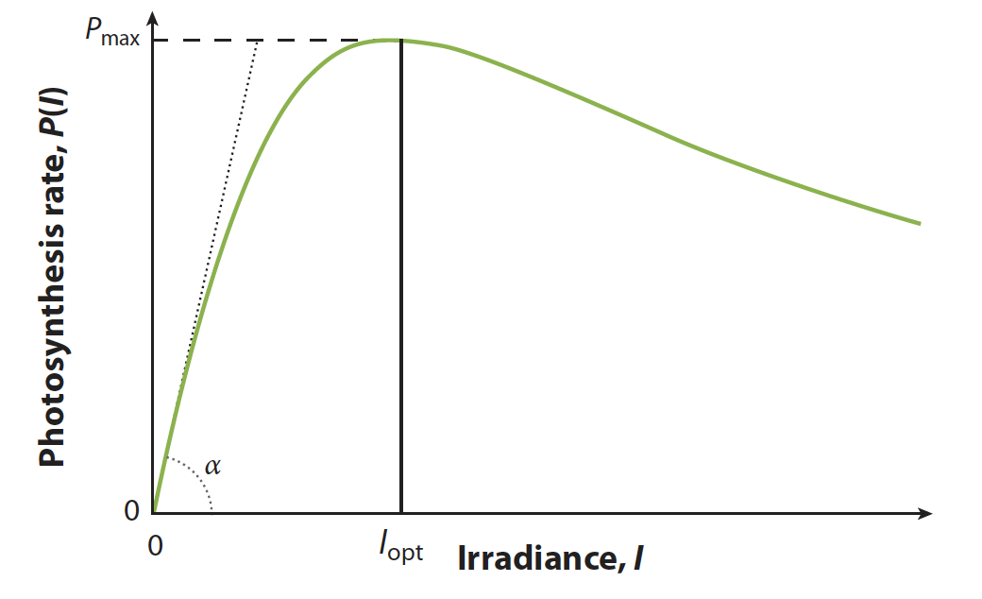
QUICK INTRO/ REFRESHER TO PLANKTON COMPETITION THEORY
Michaelis-Menten Uptake Kinetics
Droop growth function
P-I cure w/photoinhibition
Litchman and Klausmeir. (2008). ARES.

Slide 17
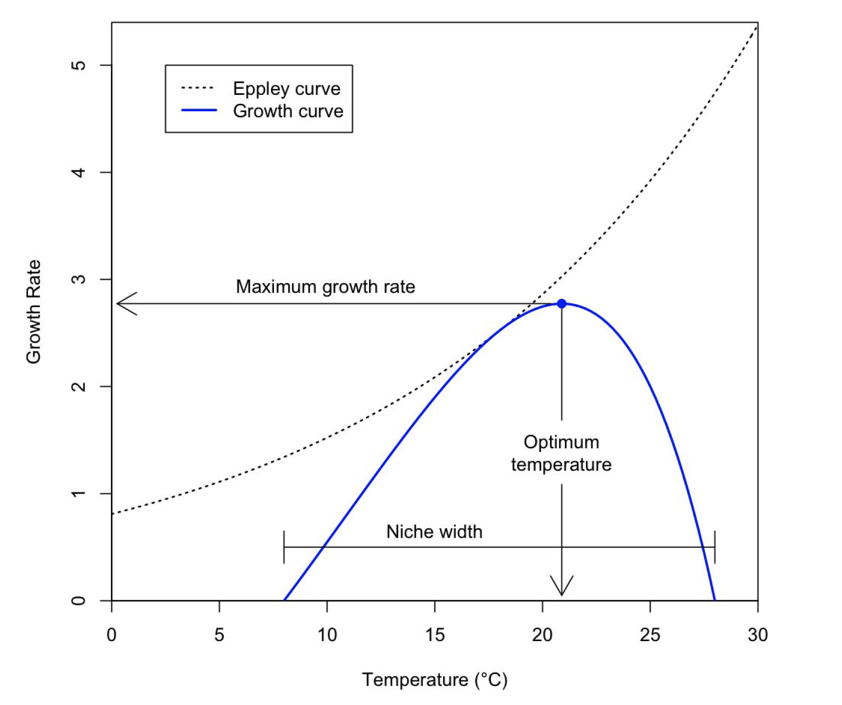
QUICK INTRO/ REFRESHER TO PLANKTON COMPETITION THEORY
Michaelis-Menten Uptake Kinetics
Droop growth function
Temperature niches
P-I cure w/photoinhibition
Litchman and Klausmeir. (2008). ARES. and Thomas et al. (2012). Science.

Slide 18
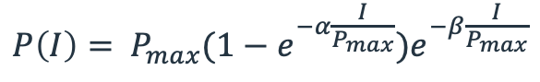
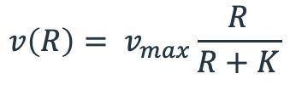
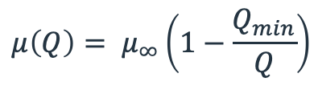
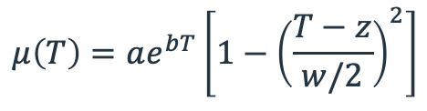
QUICK INTRO/ REFRESHER TO PLANKTON COMPETITION THEORY
Michaelis-Menten Uptake Kinetics
Droop growth function
$$μ\left(Q\right)= μ_{∞}\left(1−\frac{Q_{min}}{Q}\right)$$
$$v\left(R\right)= v_{max}\frac{R}{R+K}$$
Temperature niches
P-I cure w/photoinhibition
$$P\left(I\right)= P_{max}(1−e^{−α\frac{I}{P_{max}}})e^{−β\frac{I}{P_{max}}}$$
$$μ\left(T\right)=ae^{bT}\left[1−{\left(\frac{T−z}{w/2}\right)}^{2}\right]$$
Litchman and Klausmeir. (2008). ARES. and Thomas et al. (2012). Science.

Slide 19
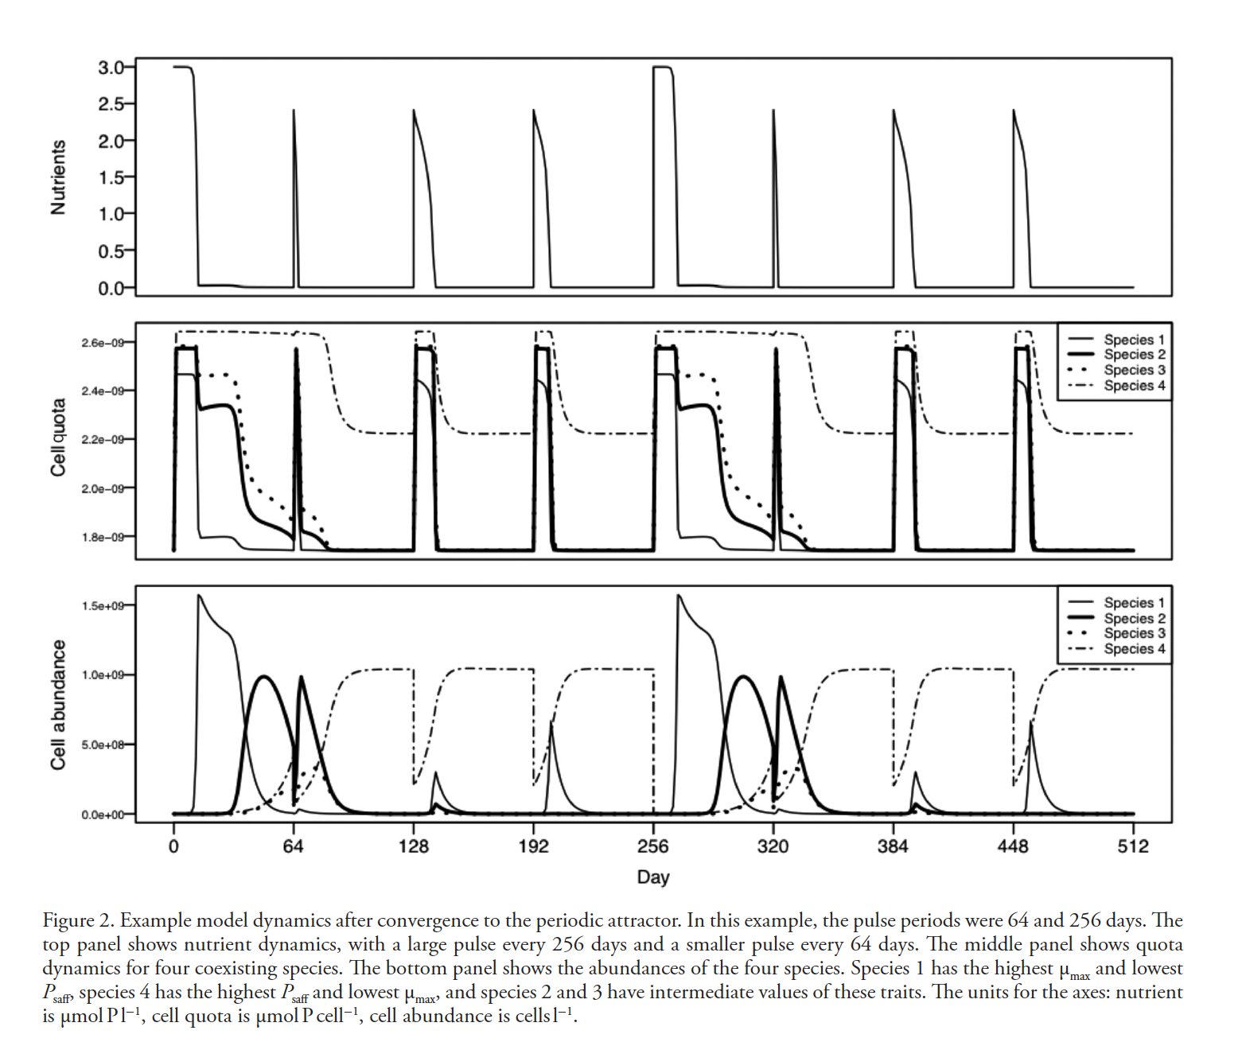
What kinds of things do I use it for?
Smith and Edwards. (2019). Oikos.

Slide 20
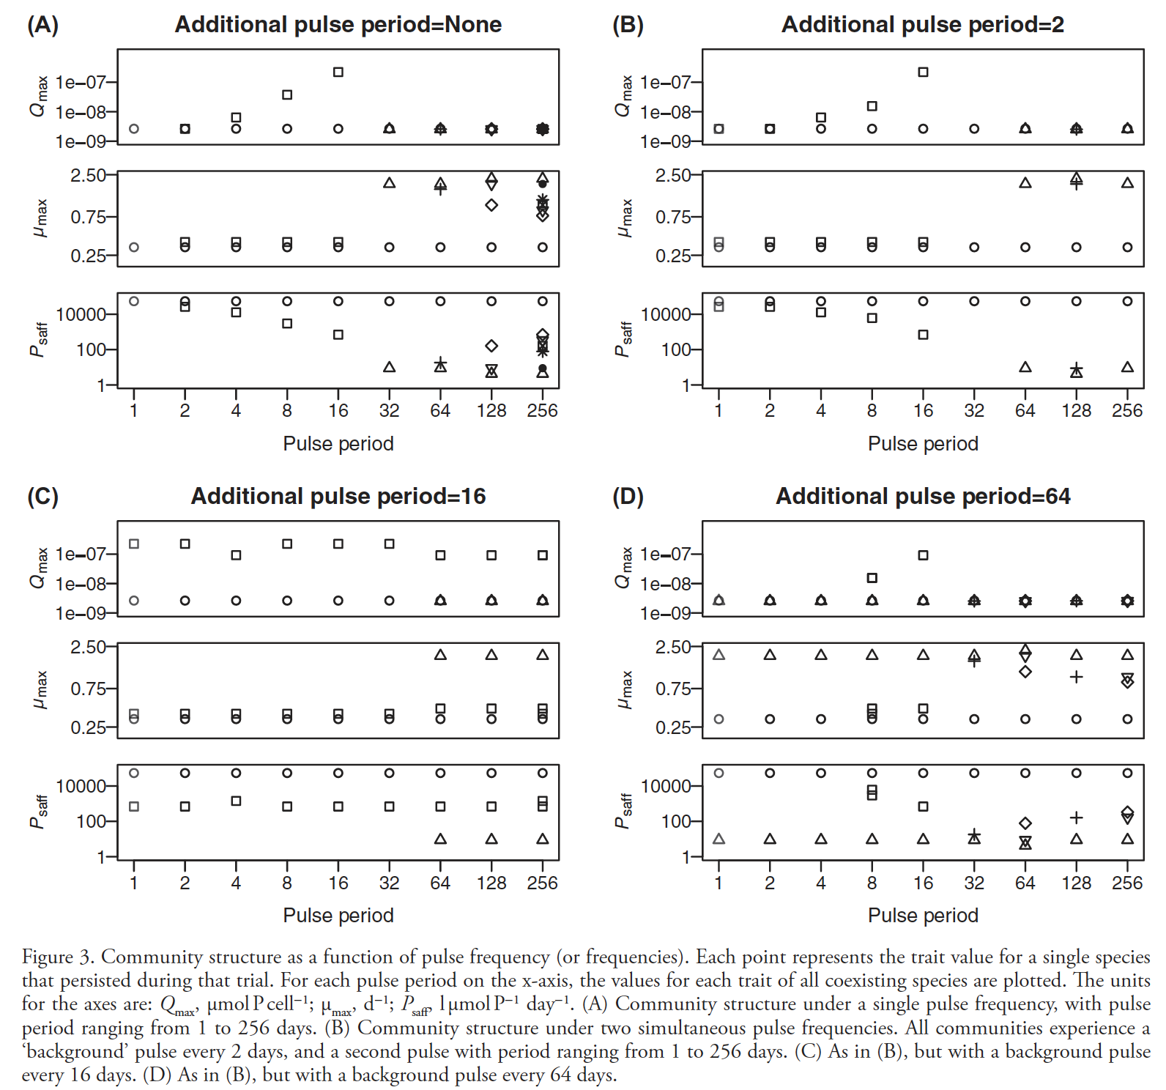
What kinds of things do I use it for?
Smith and Edwards. (2019). Oikos.

Slide 21
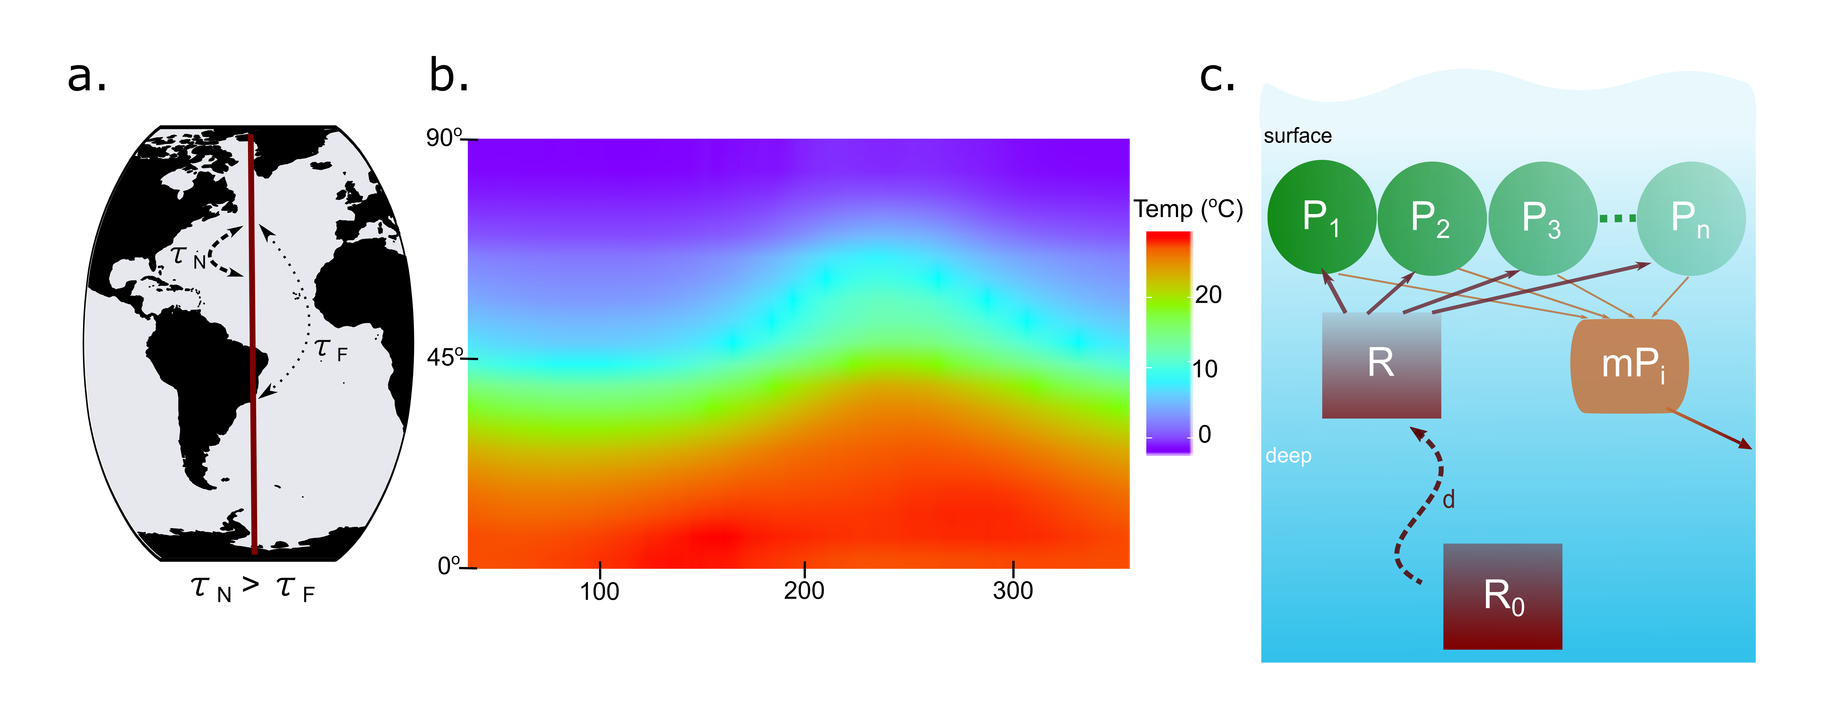
What kinds of things do I use it for?
Built a model that tests how phytoplankton communities in a metacommunity are affected by temperature variability and dispersal.

Slide 22
Coding LAB Section

Slide 23
Simple example
Time | Concentration (x10^6)
0 | 0.2162
2 | 1.0808
3 | 1.1867
4 | 2.1595
5 | 6.3756
6 | 19.4565
7 | 40.3202
8 | 81.5114
9 | 101.2929
Notes:
Now we are going to walk through this example together to give you an idea of how things work. Okay so say you have a microbe that you are growing in culture. This is the concentration data you collected over 9 hours and this is the plot of that. Now say we want to model this organism. We could first start with finding what sort of mathematical relationship concentration here has with time.

Slide 24
How do we represent this mathematically?
Hint: Describe the graph in words first. What’s the x-axis? Y-axis?
Notes:
So say you are growing microbes in culture. You might get data that looks like this which represents exponential growth. So if we were to plot this it would look like this

Slide 25
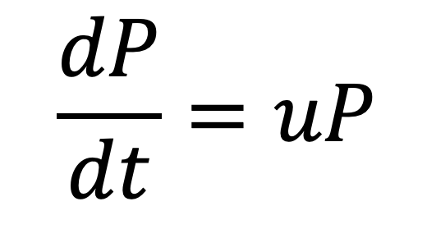
How do we represent this mathematically?
Hint: Describe the graph in words first. What’s the x-axis? Y-axis?
$$\frac{dP}{dt}=uP$$
This is an example of exponential growth – growth increases exponentially with time (no realistic mortality or outside pressures)
Notes:
Now okay let’s convert this into

Slide 26
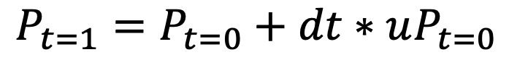
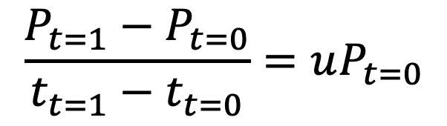
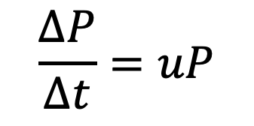
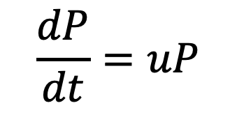
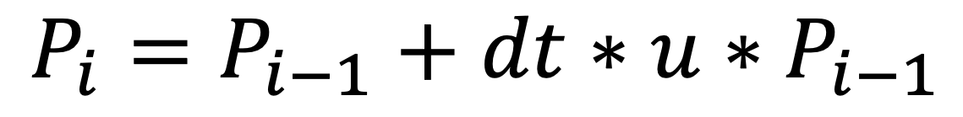
Translate to R
$$\frac{∆P}{∆t}=uP$$
$$\frac{P_{t=1}−P_{t=0}}{t_{t=1}−t_{t=0}}=uP_{t=0}$$
$$\frac{dP}{dt}=uP$$
$$P_{t=1}=P_{t=0}+dt∗uP_{t=0}$$
$$P_{i}=P_{i−1}+dt∗u∗P_{i−1}$$
Notes:
So basically, what we can use R for is to run this calculations for each time point we are interested in. So intead of manually calculating it at each time interval, we can run what’s called a loop.

Slide 27
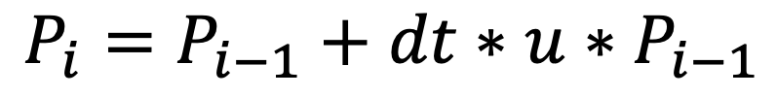
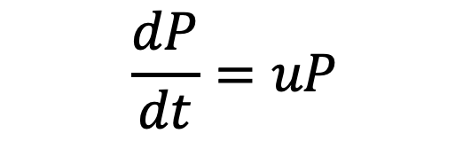
Translate to R
#Real data to compare
P_putida_time <- c(0,2,3,4,5,6,7,8,9)
P_putida_abundance <- c(0.2162, 1.0808, 1.1867, 2.1595, 6.3756, 19.4565, 40.3202, 81.5114, 101.2929)*1e6
$$\frac{dP}{dt}=uP$$
$$P_{i}=P_{i−1}+dt∗u∗P_{i−1}$$
# Model
for (i in 2:iter){
P[i] = P[i-1] + (dt*P[i-1]*r)
}
Notes:
So say you are growing microbes in culture. You might get data that looks like this which represents exponential growth. So if we were to plot this it would look like this

Slide 28
Translate to R
#Real data to compare
P_putida_time <- c(0,2,3,4,5,6,7,8,9)
P_putida_abundance <- c(0.2162, 1.0808, 1.1867, 2.1595, 6.3756, 19.4565, 40.3202, 81.5114, 101.2929)*1e6
$$\frac{dP}{dt}=uP$$
$$P_{i}=P_{i−1}+dt∗u∗P_{i−1}$$
# Model
for (i in 2:iter){
P[i] = P[i-1] + (dt*P[i-1]*r)
}
What is P at t = 0?
Notes:
So we can’t just run the model from nothing we have a few unknown variables in here that we need to provide values for. These are called the model parameters. What’s missing? What are reasonable values?? These are the kinds of questions that lead to testable hypotheses.

Slide 29
R Code
#Real data to compare
P_putida_time <- c(0,2,3,4,5,6,7,8,9)
P_putida_abundance <- c(0.2162, 1.0808, 1.1867, 2.1595, 6.3756, 19.4565, 40.3202, 81.5114, 101.2929)*1e6
# Model Parameters
r = ???? #doublings per day
P1 = P_putida_abundance[1] #abundance at t=0
day = 9/24 #9 hours*1/24 = 1/days
dt = 1/24 #1 hour= 1/days
iter = day/dt #Total number of model iterations (how many times the model has to loop)
P = vector(length=iter) #Create an empty vector to fill in abundances values as R loops and calulcates
P[1] = P1 #Populate the first value in the vector with P1
#### Model
for (i in 2:iter){
P[i] = P[i-1] + (dt*P[i-1]*r)
}
### Plotting
plot.pseudo<- ggplot()+
geom_line(aes(x=c(1:iter), y=P, col='Model'))+
geom_point(aes(x=c(1:iter), y=P, col='Model'))+
geom_line(aes(x=P_putida_time,y=P_putida_abundance, col='Real'))+
geom_point(aes(x=P_putida_time,y=P_putida_abundance, col='Real'),shape='square')+
scale_x_continuous(name=bquote(Time~(hours)))+
scale_y_continuous(name=bquote(italic(Psuedmonas~pudita)~Abundance))+
scale_color_manual(name='',values=c('Real'='black','Model'='red'))+
theme_bw()+
theme(panel.grid = element_blank(),
legend.position = c(0.2,0.8))

Slide 30
R Code
#Real data to compare
P_putida_time <- c(0,2,3,4,5,6,7,8,9)
P_putida_abundance <- c(0.2162, 1.0808, 1.1867, 2.1595, 6.3756, 19.4565, 40.3202, 81.5114, 101.2929)*1e6
# Model Parameters
r = ???? #doublings per day
P1 = P_putida_abundance[1]
day = 9/24 #9 hours*1/24 = 1/days
dt = 1/24 #1 hour= 1/days
iter = day/dt
P = vector(length=iter)
P[1] = P1
####Model
for (i in 2:iter){
P[i] = P[i-1] + (dt*P[i-1]*r)
}
### Plotting
plot.pseudo<- ggplot()+
geom_line(aes(x=c(1:iter), y=P, col='Model'))+
geom_point(aes(x=c(1:iter), y=P, col='Model'))+
geom_line(aes(x=P_putida_time,y=P_putida_abundance, col='Real'))+
geom_point(aes(x=P_putida_time,y=P_putida_abundance, col='Real'),shape='square')+
scale_x_continuous(name=bquote(Time~(hours)))+
scale_y_continuous(name=bquote(italic(Psuedmonas~pudita)~Abundance))+
scale_color_manual(name='',values=c('Real'='black','Model'='red'))+
theme_bw()+
theme(panel.grid = element_blank(),
legend.position = c(0.2,0.8))

Slide 31
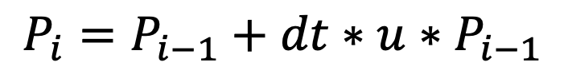
Practice
$$P_{i}=P_{i−1}+dt∗u∗P_{i−1}$$
- What happens when you change dt?
-What is an appropriate u that makes the model comparable to the real data?
Let’s test it!
Notes:
So say you are growing microbes in culture. You might get data that looks like this which represents exponential growth. So if we were to plot this it would look like this

Slide 32
Generic Steps
Visualize what processes you’re trying to model like literally draw it out so you can understand what parameters you need, what direction ‘energy’ is flowing and what the inputs/outputs are
Write out the equations
Convert the written equations into code speech
Write the rest of the code and fill in the parameters
Run it and test your hypotheses!

Slide 33
Let’s build Up a simple model of community dynamics!

Slide 34
Step 1: Visualize what were doing – NPZ model (Nutrients-Phytoplankton-Zooplankton
Name some relationships between phytoplankton (P), zooplankton (Z), the nutrient pool (N), and the environment (i.e. depth, temperature, light, etc.)
P
Nutrients
(Mixed Layer)
Z
Nutrients
(Deep)

Slide 35
Step 1: Visualize what were doing – NPZ model (Nutrients-Phytoplankton-Zooplankton
Name some relationships between phytoplankton (P), zooplankton (Z), the nutrient pool (N), and the environment (i.e. depth, temperature, light, etc.)
P
Concentration of nutrients
Phytoplankton nutrient uptake kinetics
Zooplankton grazing
Phytoplankton light dependent growth
Phytoplankton temp dependent growth
Phytoplankton mortality
Zooplankton mortality
Zooplankton ‘sloppy feeding’
Higher trophic predation
Physical dynamics (advection, mixing)
Chemical reactions
CO₂ concentration
etc…..
Nutrients (Mixed Layer)
Z
Nutrients (Deep)

Slide 36
Step 1: Visualize what were doing – NPZ model (Nutrients-Phytoplankton-Zooplankton
Let’s simplify it!!
P
Nutrient uptake
Concentration of nutrients
Phytoplankton nutrient uptake kinetics
Zooplankton grazing
Phytoplankton light dependent growth
Phytoplankton temp dependent growth
Phytoplankton mortality
Zooplankton mortality
Zooplankton ‘sloppy feeding’
Higher trophic predation
Physical dynamics (advection, mixing)
Chemical reactions
CO₂ concentration
etc…..
Mortality assuming remineralization
‘Sloppy feeding'
Nutrients (Mixed Layer)
Grazing
Z
Mortality assuming remineralization
Deep mixing
Nutrients (Deep)

Slide 37
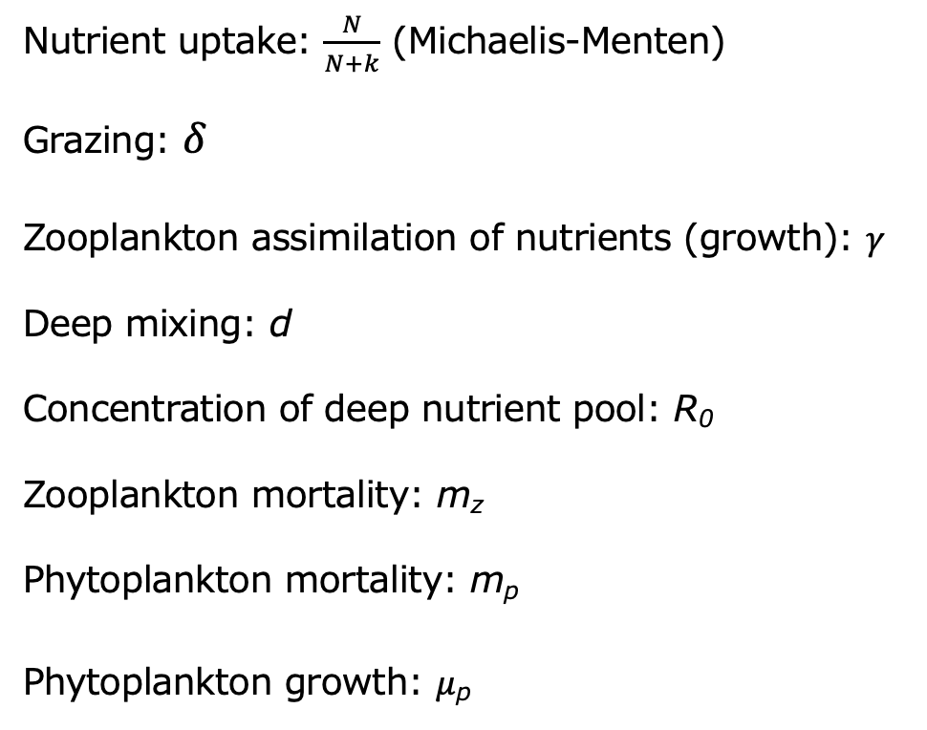
Step 2: Write out the equations – Define the parameters
Nutrient uptake: $\frac{N}{N+k}$ (Michaelis-Menten)
Grazing: $δ$
Zooplankton assimilation of nutrients (growth): $γ$
Deep mixing: d
Concentration of deep nutrient pool: R₀
Zooplankton mortality: m_{z}
Phytoplankton mortality: m_{p}
Phytoplankton growth: $μ$_{p}
P
Nutrient uptake
Mortality assuming remineralization
‘Sloppy feeding'
Nutrients
Grazing
Z
Mortality assuming remineralization
Deep mixing
Nutrients

Slide 38
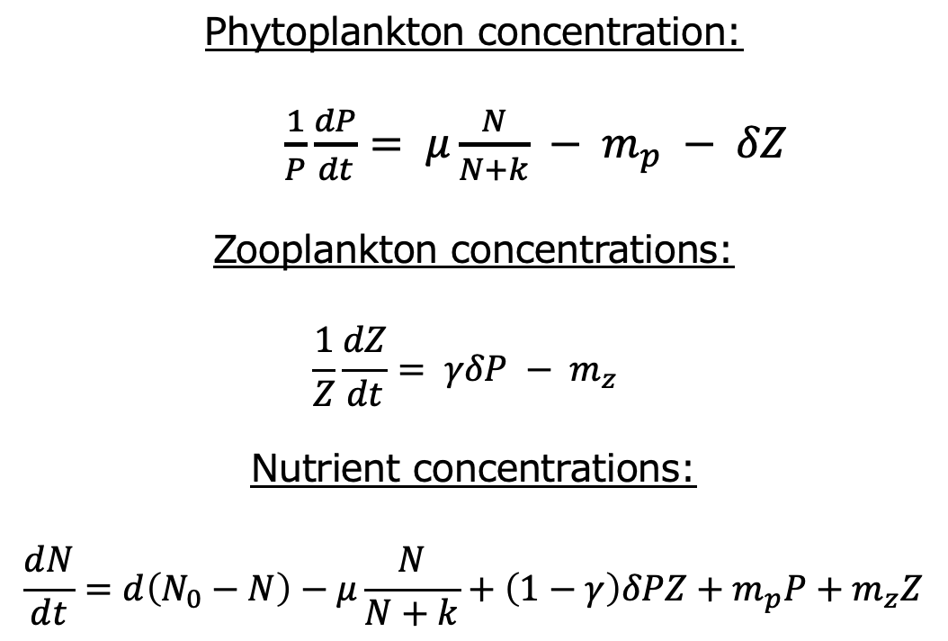
Step 2: Write out the equations – Define the state equations
P
Phytoplankton concentration:
$\frac{1}{P}\frac{dP}{dt}= μ\frac{N}{N+k} − m_{p} − δZ$
Zooplankton concentrations:
$$\frac{1}{Z}\frac{dZ}{dt}= γδP − m_{z}$$
Nutrient concentrations:
$$\frac{dN}{dt}=d\left(N_{0}−N\right)−μ\frac{N}{N+k}+\left(1−γ\right)δPZ+m_{p}P+m_{z}Z$$
Nutrient uptake
Mortality assuming remineralization
‘Sloppy feeding'
Nutrients (Mixed Layer)
Grazing
Z
Mortality assuming remineralization
Deep mixing
Nutrients (Deep)

Slide 39
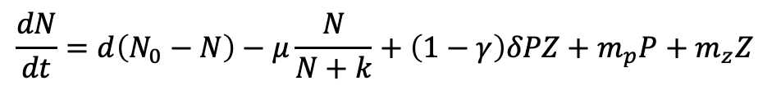
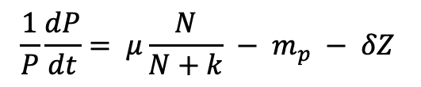
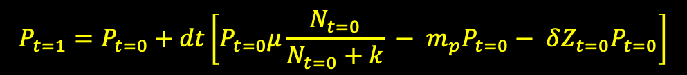
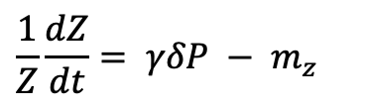
Step 3: Write out the equations to translate to R
$$\frac{1}{P}\frac{dP}{dt}= μ\frac{N}{N+k} − m_{p} − δZ$$
$$P_{t=1}=P_{t=0}+dt\left[P_{t=0}μ\frac{N_{t=0}}{N_{t=0}+k} − m_{p}P_{t=0}− δZ_{t=0}P_{t=0}\right]$$
$$\frac{1}{Z}\frac{dZ}{dt}= γδP − m_{z}$$
$$Z_{t=1}=Z_{t=0}+dt\left[γδZ_{t=0}P_{t=0} − m_{z}Z_{t=0}\right]$$
$$\frac{dN}{dt}=d\left(N_{0}−N\right)−μ\frac{N}{N+k}+\left(1−γ\right)δPZ+m_{p}P+m_{z}Z$$
$$N_{t=1}=N_{t=0}+dt\left[d\left(N_{0}−N_{t=0}\right)−μ\frac{N_{t=0}}{N_{t=0}+k}+\left(1−γ\right)δP_{t=0}Z_{t=0}+m_{p}P_{t=0}+m_{z}Z_{t=0}\right]$$

Slide 40
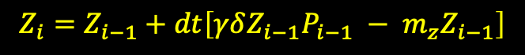
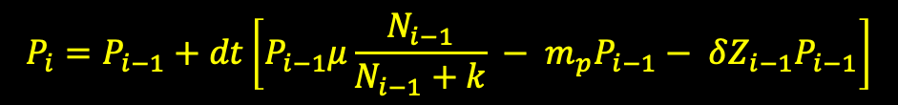
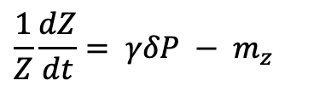
Step 3: Write out the equations to translate to R
$$\frac{1}{P}\frac{dP}{dt}= μ\frac{N}{N+k} − m_{p} − δZ$$
$$P_{i}=P_{i−1}+dt\left[P_{i−1}μ\frac{N_{i−1}}{N_{i−1}+k} − m_{p}P_{i−1}− δZ_{i−1}P_{i−1}\right]$$
$$\frac{1}{Z}\frac{dZ}{dt}= γδP − m_{z}$$
$$Z_{i}=Z_{i−1}+dt\left[γδZ_{i−1}P_{i−1} − m_{z}Z_{i−1}\right]$$
$$\frac{dN}{dt}=d\left(N_{0}−N\right)−μ\frac{N}{N+k}+\left(1−γ\right)δPZ+m_{p}P+m_{z}Z$$
$$N_{i}=N_{i−1}+dt \left[d\left(N_{0}−N_{i−1}\right)−μ\frac{N_{i−1}}{N_{i−1}+k}+\left(1−γ\right)δP_{i−1}Z_{i−1}+m_{p}P_{i−1}+m_{z}Z_{i−1}\right]$$

Slide 41
Step 4: Write out the code into R – Step 1 write the equations in a loop through time (i)
$$N_{i}=N_{i−1}+dt \left[d\left(N_{0}−N_{i−1}\right)−μ\frac{N_{i−1}}{N_{i−1}+k}+\left(1−γ\right)δP_{i−1}Z_{i−1}+m_{p}P_{i−1}+m_{z}Z_{i−1}\right]$$
N[i] <- N[i-1] + dt * (d*(N.0-N[i-1])-(u * P[i-1] * (N[i-1] / (N[i-1] + k))) + (1-ro) * ga * P[i-1]* Z[i-1] + m * P[i-1] + yt * Z[i-1])

Slide 42
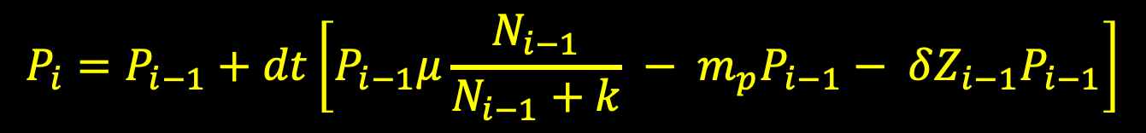
Step 4: Write out the code into R – Step 1 write the equations in a loop through time (i)
$$P_{i}=P_{i−1}+dt\left[P_{i−1}μ\frac{N_{i−1}}{N_{i−1}+k} − m_{p}P_{i−1}− δZ_{i−1}P_{i−1}\right]$$
P[i] <- P[i-1] + dt * ((u * P[i-1] * (N[i-1] / (N[i-1] + k))) - m * P[i-1] - ga * P[i-1] * Z[i-1])

Slide 43
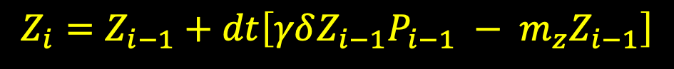
Step 4: Write out the code into R – Step 1 write the equations in a loop through time (i)
$$Z_{i}=Z_{i−1}+dt\left[γδZ_{i−1}P_{i−1} − m_{z}Z_{i−1}\right]$$
Z[i] <- Z[i-1] + dt * (ro * ga * Z[i-1] * P[i-1] - yt * Z[i-1])

Slide 44
Step 4: Write out the code into R – Step 1 write the equations in a loop through time (i)
#### Start with writing out the model equations looping through time
for (i in 2:iter){
P[i] <- P[i-1] + dt * ((u * P[i-1] * (N[i-1] / (N[i-1] + k))) - m * P[i-1] - ga * P[i-1] * Z[i-1])
Z[i] <- Z[i-1] + dt * (ro * ga * Z[i-1] * P[i-1] - yt * Z[i-1])
N[i] <- N[i-1] + dt * (d*(N.0-N[i-1])-(u * P[i-1] * (N[i-1] / (N[i-1] + k))) + (1-ro) * ga * P[i-1] * Z[i-1] + m * P[i-1] + yt * Z[i-1])
}

Slide 45
Step 4: Write out the code into R – Then write out all of the parameters and state variables
#### Identify parameters
for (i in 2:iter){
P[i] <- P[i-1] + dt * ((u * P[i-1] * (N[i-1] / (N[i-1] + k))) - m * P[i-1] - ga * P[i-1] * Z[i-1])
Z[i] <- Z[i-1] + dt * (ro * ga * Z[i-1] * P[i-1] - yt * Z[i-1])
N[i] <- N[i-1] + dt * (d*(N.0-N[i-1])-(u * P[i-1] * (N[i-1] / (N[i-1] + k))) + (1-ro) * ga * P[i-1] * Z[i-1] + m * P[i-1] + yt * Z[i-1])
}

Slide 46
Step 4: Write out the code into R – Then write out all of the parameters and state variables
#### Model
for (i in 2:iter){
P[i] <- P[i-1] + dt * ((u * P[i-1] * (N[i-1] / (N[i-1] + k))) - m * P[i-1] - ga * P[i-1] * Z[i-1])
Z[i] <- Z[i-1] + dt * (ro * ga * Z[i-1] * P[i-1] - yt * Z[i-1])
N[i] <- N[i-1] + dt * (d*(N.0-N[i-1])-(u * P[i-1] * (N[i-1] / (N[i-1] + k))) + (1-ro) * ga * P[i-1] * Z[i-1] + m * P[i-1] + yt * Z[i-1])
}
#### Define your parameters
dt <- 1/24 #time step in hours converted to days
years <- 5 #how many years to run the model
days <- 365*years #how many days in total
iter <- days/dt #convert that to time steps
u <- 1.4 #doublings per day
k <- 1 #half-saturation constant
m <- 0.3 #fraction of death per day
ga <- 0.6 #predation fraction
ro <- 0.3 #integration of P into Z
yt <- 0.1 #fraction of natural Z death
d <- 0.8 #Supply of nutrients from the deep
N.0 <- 0.8 #Deep concentration of nutrients

Slide 47
Step 4: Write out the code into R – Then write out all of the parameters and state variables
#### Model
for (i in 2:iter){
P[i] <- P[i-1] + dt * ((u * P[i-1] * (N[i-1] / (N[i-1] + k))) - m * P[i-1] - ga * P[i-1] * Z[i-1])
Z[i] <- Z[i-1] + dt * (ro * ga * Z[i-1] * P[i-1] - yt * Z[i-1])
N[i] <- N[i-1] + dt * (d*(N.0-N[i-1])-(u * P[i-1] * (N[i-1] / (N[i-1] + k))) + (1-ro) * ga * P[i-1] * Z[i-1] + m * P[i-1] + yt * Z[i-1])
}
#### Define your parameters
dt <- 1/24 #time step in hours converted to days
years <- 5 #how many years to run the model
days <- 365*years #how many days in total
iter <- days/dt #convert that to time steps
u <- 1.4 #doublings per day
k <- 1 #half-saturation constant
m <- 0.3 #fraction of death per day
ga <- 0.6 #predation fraction
ro <- 0.3 #integration of P into Z
yt <- 0.1 #fraction of natural Z death
d <- 0.8 #Supply of nutrients from the deep
N.0 <- 0.8 #Deep concentration of nutrients
##### Set up your initial conditions (i.e. t=0)
P.init <- 1
Z.init<- 1
N.init <- 1
#### Create your vectors/matricies
P <- vector(length=iter)*NA
P[1]<-P.init
Z <- vector(length=iter)*NA
Z[1] <- Z.init
N <- vector(length=iter)*NA
N[1] <- N.init

Slide 48
#### Start with defining your parameters
dt <- 1/24 #time step in hours converted to days
years <- 5 #how many years to run the model
days <- 365*years #how many days in total
iter <- days/dt #convert that to time steps
u <- 1.4 #doublings per day
k <- 1 #half-saturation constant
m <- 0.3 #fraction of death per day
ga <- 0.6 #predation fraction
ro <- 0.3 #integration of P into Z
yt <- 0.1 #fraction of natural Z death
d <- 0.8 #Supply of nutrients from the deep
N.0 <- 0.8 #Deep concentration of nutrients
##### Set up your initial conditions (i.e. t=0)
P.init <- 1
Z.init<- 1
N.init <- 1
#### Create your vectors/matricies
P <- vector(length=iter)*NA
P[1]<-P.init
Z <- vector(length=iter)*NA
Z[1] <- Z.init
N <- vector(length=iter)*NA
N[1] <- N.init
#### Model
for (i in 2:iter){
P[i] <- P[i-1] + dt * ((u * P[i-1] * (N[i-1] / (N[i-1] + k))) - m * P[i-1] - ga * P[i-1] * Z[i-1])
Z[i] <- Z[i-1] + dt * (ro * ga * Z[i-1] * P[i-1] - yt * Z[i-1])
N[i] <- N[i-1] + dt * (d*(N.0-N[i-1])-(u * P[i-1] * (N[i-1] / (N[i-1] + k))) + (1-ro) * ga * P[i-1] * Z[i-1] + m * P[i-1] + yt * Z[i-1])
}

Slide 49
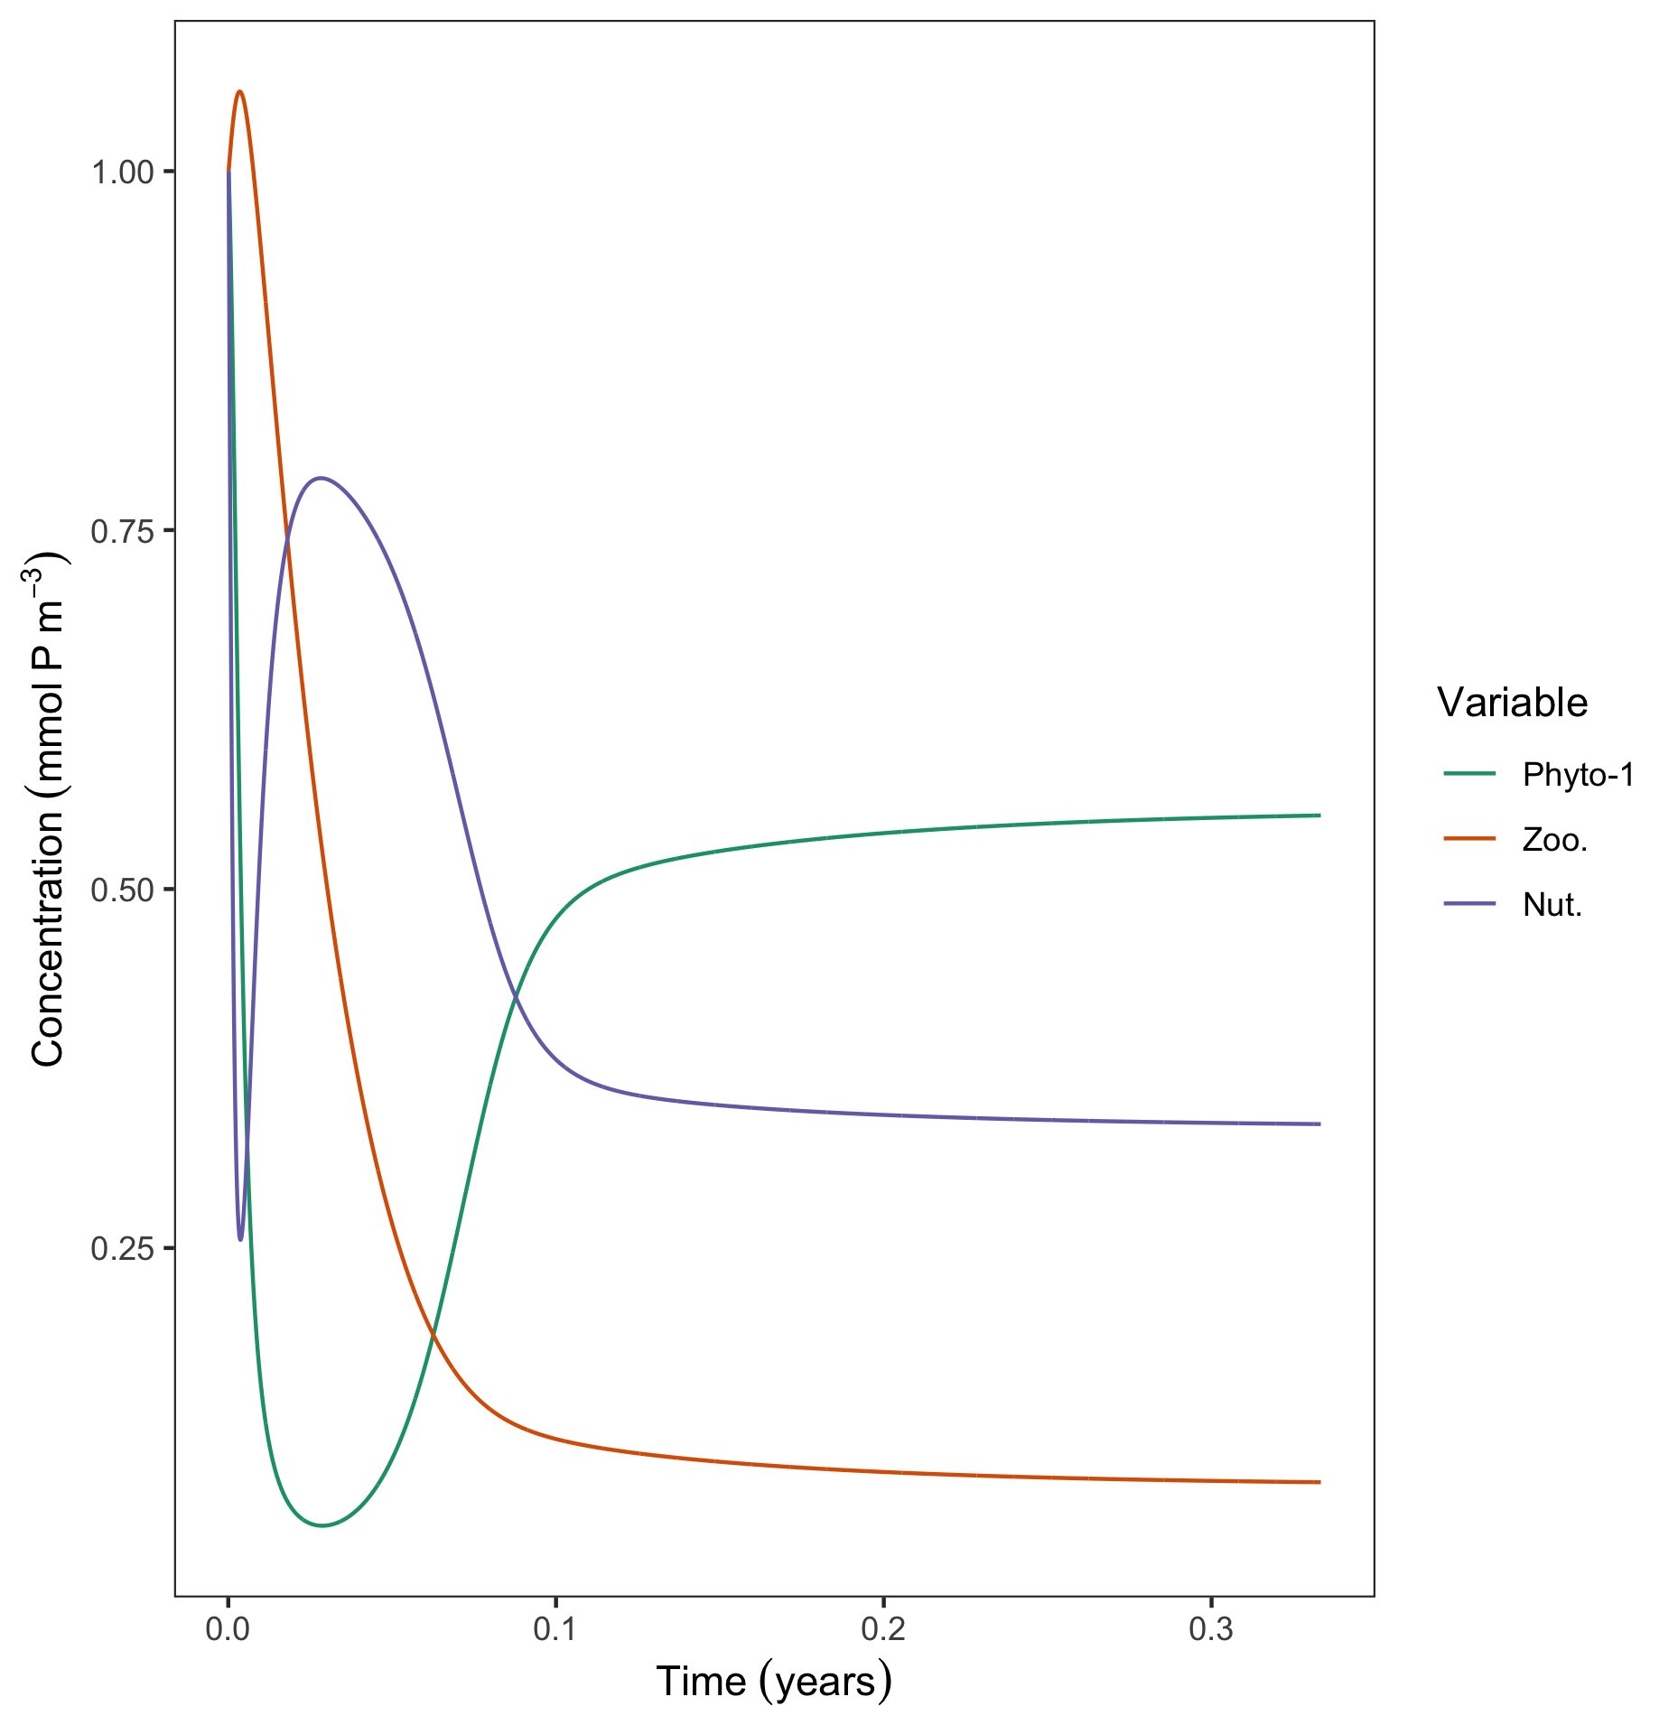
Step 5: Run it and see what happens!
##### Base R plotting code
plot(c(1:iter),P ,ty=‘l’)
lines(c(1:iter),Z, ty=‘l’,col='red')
lines(c(1:iter),N, ty=‘l’,col=‘blue')
### ggplot plotting code
com.mat<-data.frame(time=1:iter,P=P,Z=Z,N=N) #[1:(iter/15),] look at the first couple of months instead of the whole 5 years
com.mat.melt<-melt(com.mat,'time’)
ggplot(data=com.mat.melt)+
geom_line(aes(x=time/(24*365),y=value,col=variable))+
scale_x_continuous(name=bquote(Time~(years)))+
scale_y_continuous(name=bquote(Concentration~(mmol~P~m^3)))+
scale_color_brewer(name=bquote(Variable),palette="Dark2",
labels=c('Phyto-1', 'Zoo.','Nut.'))+
theme_bw()+
theme(panel.grid = element_blank())

Slide 50
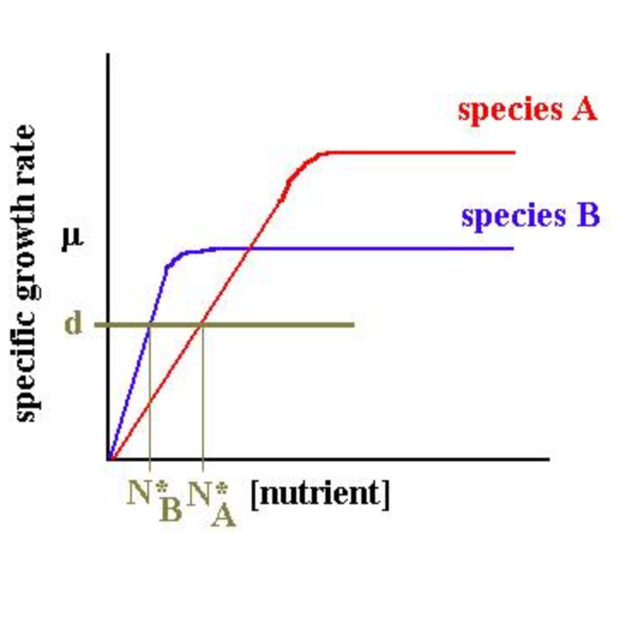
Let’s explore community dynamics
Michaelis-Menten uptake kinetics:
Each species has a unique response to temperature where growth rate increases as nutrient concentration increases up until a plateau. Some species have higher maximum growth rates but as a penalty they require more nutrients to reach that growth rate.
N*= half-saturation constant or the concentration of nutrients where a species reaches its half-maximum growth rate

Slide 51
Step 4: Write out the code into R – This time we are including two species that are competing
#### Start with defining your parameters
n<-2 #Number of phytoplankton species
dt <- 1/24 #time step in hours converted to days
years <- 5 #how many years to run the model
days <- 365*years #how many days in total
iter <- days/dt #convert that to time steps
u <- c(1.2,0.6) #doublings per day
k <- c(1,0.2) #half-saturation constant
m <- 0.3 #fraction of death per day
ga <- 0.6 #predation fraction
ro <- 0.3 #integration of P into Z
yt <- 0.1 #fraction of natural Z death
d <- 0.8 #Supply of nutrients from the deep
N.0 <- 0.8 #Deep concentration of nutrients
##### Set up your initial conditions (i.e. t=0)
P.init <- 1
Z.init<- 1
N.init <- 1
#### Create your vectors/matricies
# P <- vector(length=iter)*NA
# P[1]<-P.init
P <- matrix(NA,nrow=iter, ncol=n)
P[1,]<-P.init
Z <- vector(length=iter)*NA
Z[1] <- Z.init
N <- vector(length=iter)*NA
N[1] <- N.init
#### Model
for (i in 2:iter){
P[i,] <- P[i-1,] + dt * ((u * P[i-1,] * (N[i-1] / (N[i-1] + k))) - m * P[i-1,] - ga * P[i-1,] * Z[i-1])
Z[i] <- Z[i-1] + dt * (sum(ro * ga * Z[i-1] * P[i-1,]) - yt * Z[i-1])
N[i] <- N[i-1] + dt * (d*(N.0-N[i-1])-sum((u * P[i-1,] * (N[i-1] / (N[i-1] + k))) + (1-ro) * ga * P[i-1,] * Z[i-1] + m * P[i-1,],na.rm=T) + yt * Z[i-1])
}

Slide 52
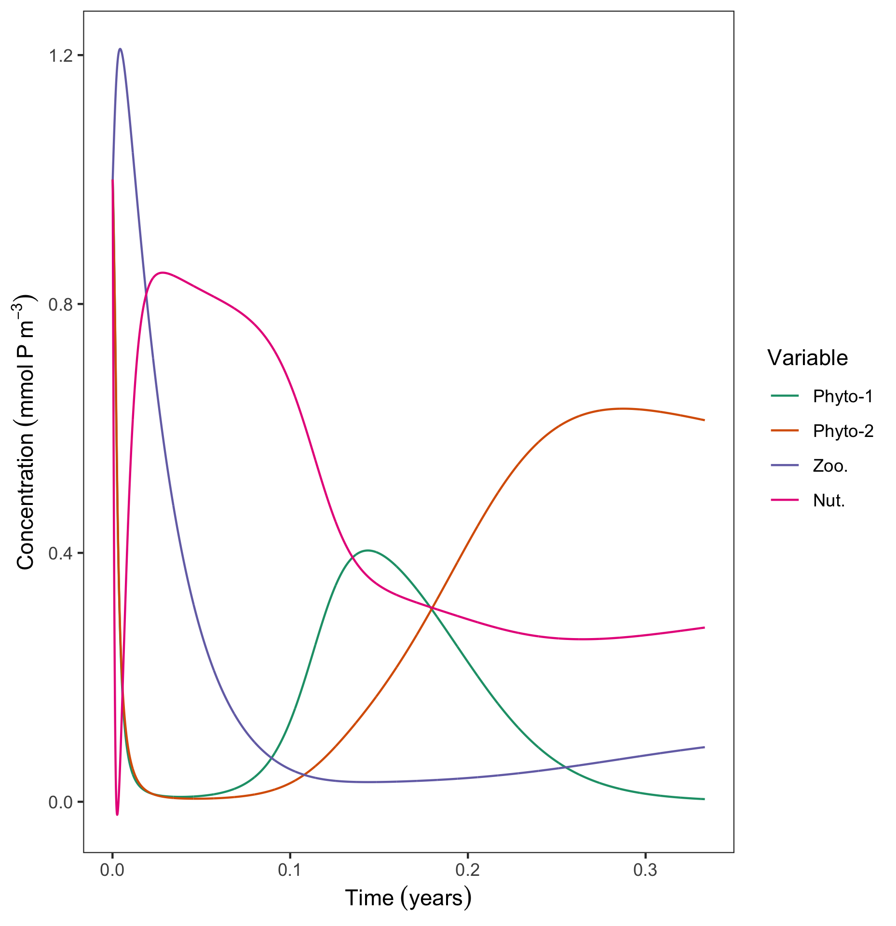
Step 5: Run it and see what happens!
##### Base R plotting code
matplot(c(1:iter),P ,ty=‘l’)
lines(c(1:iter),Z, ty=‘l’,col='red')
lines(c(1:iter),N, ty=‘l’,col=‘blue')
### Ggplot plotting code
com.mat<-data.frame(time=1:iter,P=P,Z=Z,N=N) #[1:(iter/15),] look at the first couple of months instead of the whole 5 years
com.mat.melt<-melt(com.mat,'time’)
ggplot(data=com.mat.melt)+
geom_line(aes(x=time/(24*365),y=value,col=variable))+
scale_x_continuous(name=bquote(Time~(years)))+
scale_y_continuous(name=bquote(Concentration~(mmol~P~m^3)))+
scale_color_brewer(name=bquote(Variable),palette="Dark2",
labels=c('Phyto-1’, ‘Phyto-2’,'Zoo.','Nut.'))+
theme_bw()+
theme(panel.grid = element_blank())
Notes:
Split up the lectures into lecture and lab like only theory and “math” and then the code is saved for lab.

Slide 53
Go forth and theoretically conquer!

Slide 54
References
Caswell, H. (1988). Ecological Modelling. 43: 33-44.
Barton, A.D. et al. (2016). PNAS. 113: (11)
Follows, M.J. et al. (2007). Science. 315 (5820): 1843-1846.
Smith, A.N. and Edwards, K.F. (2019). Oikos. 00: 1–13.
Franks, P. J. (2002)., Journal of Oceanography. 58: 379-387
Notes:
I study phytoplankton community dynamics specifically but you can apply mathematic principles to literally anything. For example, the model I built in undergrad was actually with some economists. This is why models are so great because they can be applied across a variety of different fields.

